Slide 1

CIRCUIT BREAKER PATTERN

Slide 2

Agenda
the problem
SOLUTION
Hands-on

Slide 3

1
the problem

Slide 4



In a microservice architecture services will collaborate wen handling requests
When one service is synchronously calling another one there is always the possibility that the other service is unavailable
Precious resources such as threads (CPU) might be consumed in the caller while waiting for the other service to respond
Pretty fast the caller will get to resource exhaustion meaning that will be unable to handle other requests
The failure of one service can potentially cascade to other services throughout the application
Notes:
Data slide (version 5)
Tables are mostly used to show the cost of the project.
If the table is not too extensive, as shown here, use elements to reinforce or remind the audience of key ideas or information.

Slide 5
We need a tool which should check if any failures occurred in the system and recover automatically if any errors are reported
Notes:
Data slide (version 5)
Tables are mostly used to show the cost of the project.
If the table is not too extensive, as shown here, use elements to reinforce or remind the audience of key ideas or information.

Slide 6
1
Solution

Slide 7
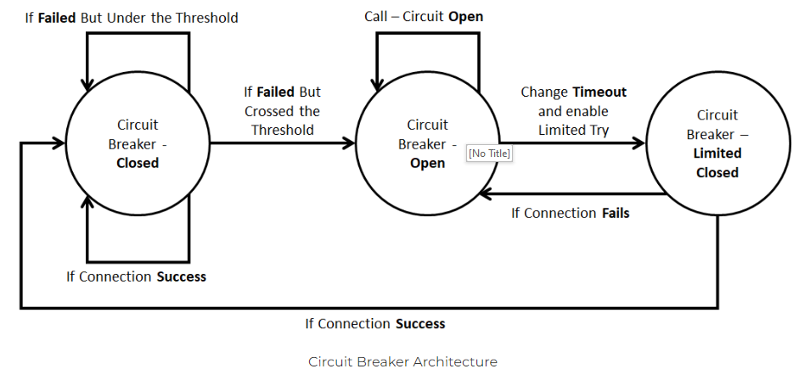
CIRCUIT
BREAKER
https://digitalvarys.com/

Slide 8
Circuit Breaker Closed – allow connections through
Circuit Breaker Open – break the connection
CIRCUIT
BREAKER
Circuit Breaker Limited Closed – allow limited number of connection to test if the connection is stable
https://digitalvarys.com/

Slide 9
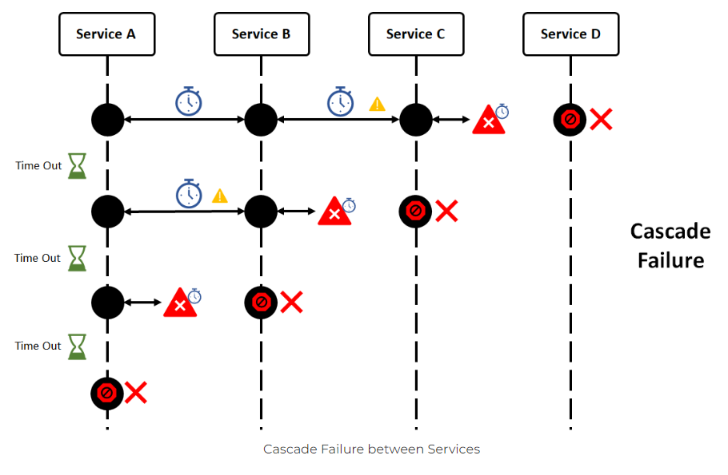
CIRCUIT
BREAKER
https://digitalvarys.com/

Slide 10
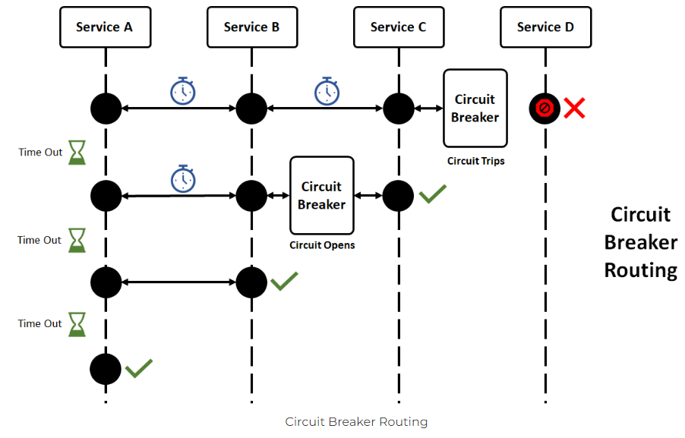
CIRCUIT
BREAKER
https://digitalvarys.com/

Slide 11
It provides an abstraction layer across different circuit breaker implementations
Spring cloud
Circuit
breaker
It is pluggable – we code against the abstraction and switch easily to another implementation
Most used implementations: Resilience4J and Netflix Hystrix

Slide 12
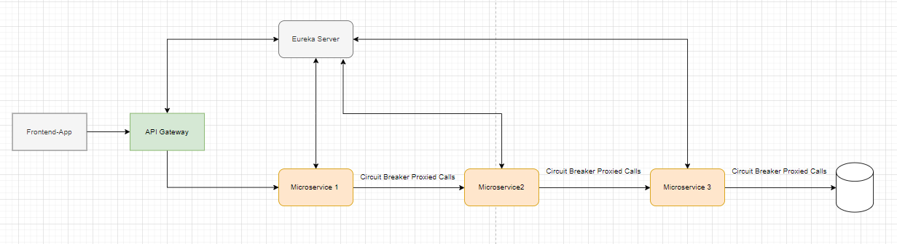
Config
server

Slide 13
1
Hands-on

